Slide 1
Data Mining in
Retail Insutry

Slide 2
Data Mining
Name: Ammrit Preet Kaur Tuteja
Student ID: 501037031
Supervisor: Dr. Tamer

Slide 3
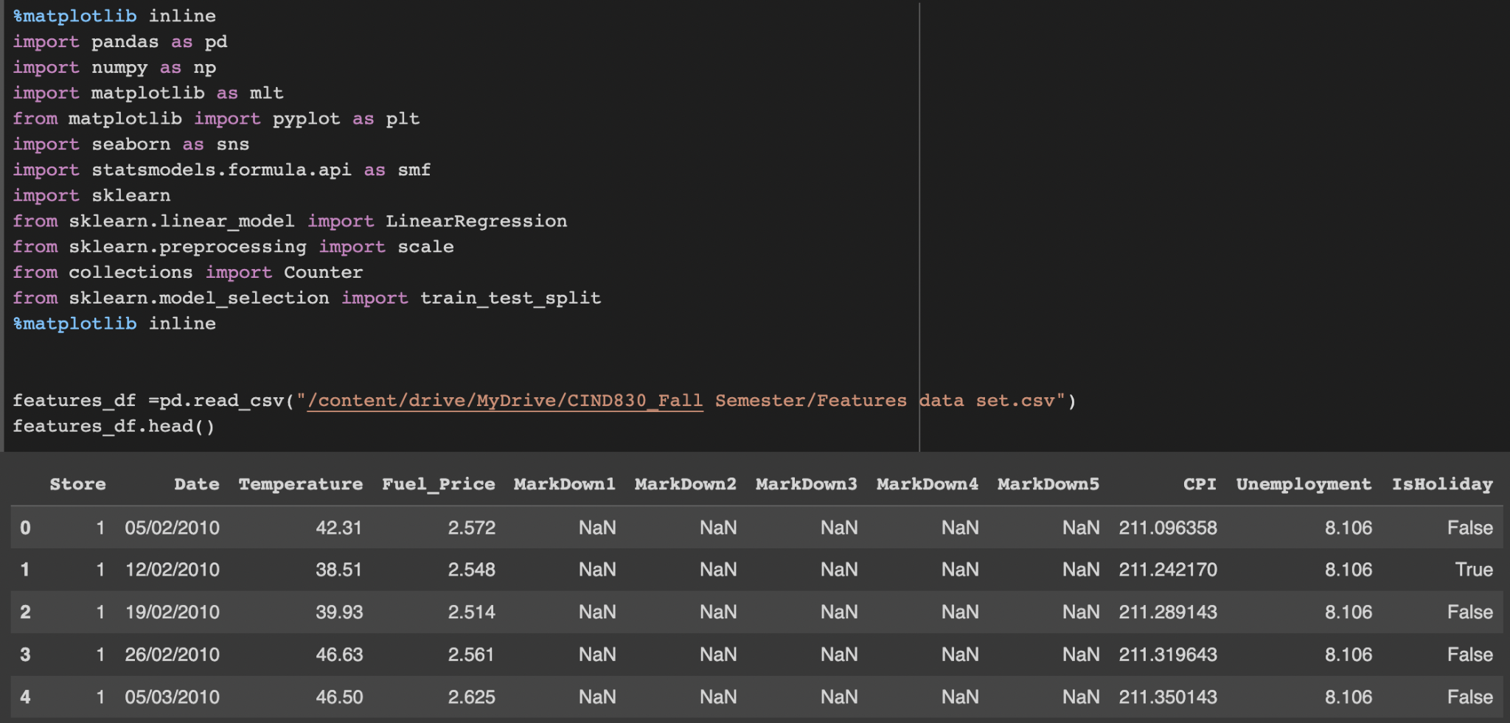
Project Overview
Retail Dataset which has 3 spreadsheets as below:
Stores - 45 stores indicating the type and size of the store.
Features - Temperature, fuel prices, markdowns, employment status and consumer price index.
Weekly sales for a particular store and department and whether it is a holiday season week or not.

Slide 4
Problems being tacked:
Do costing factors like fuel price affect the markdowns offered by the stores?
Does infusing markdowns have an effect on sales?

Slide 5
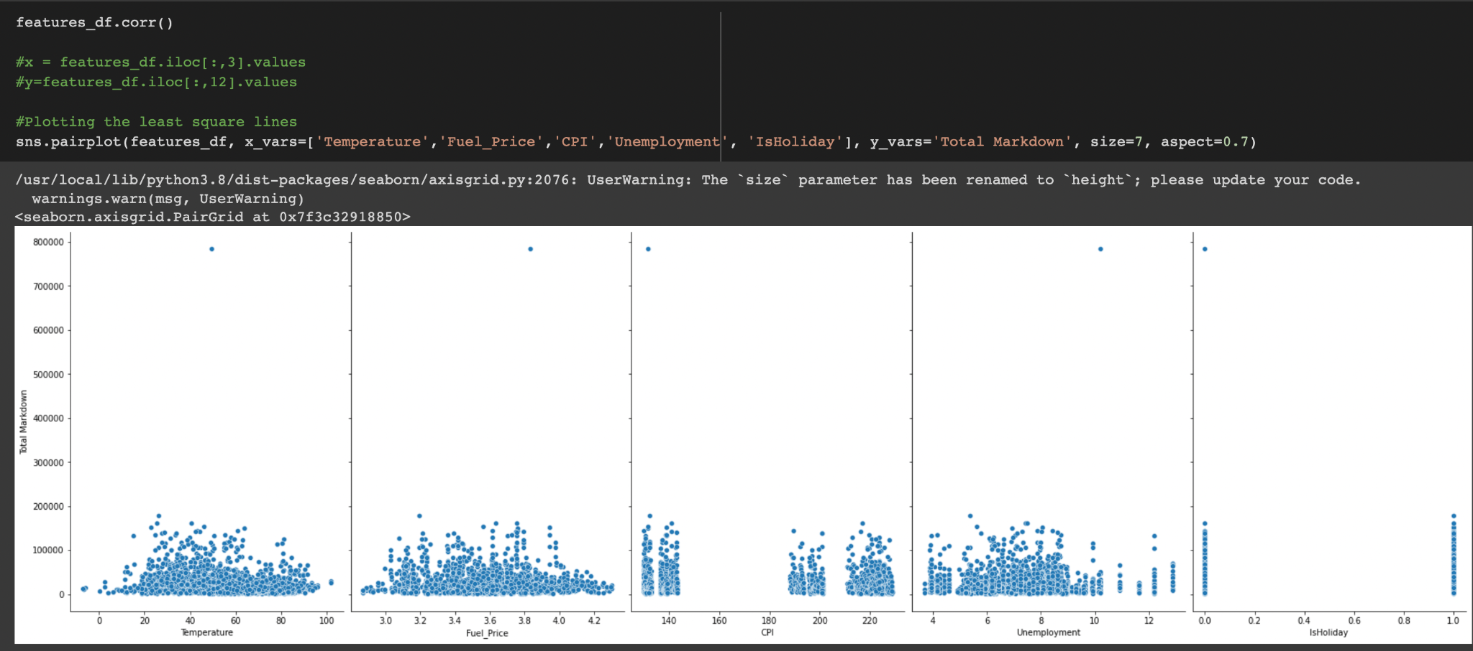

Slide 6
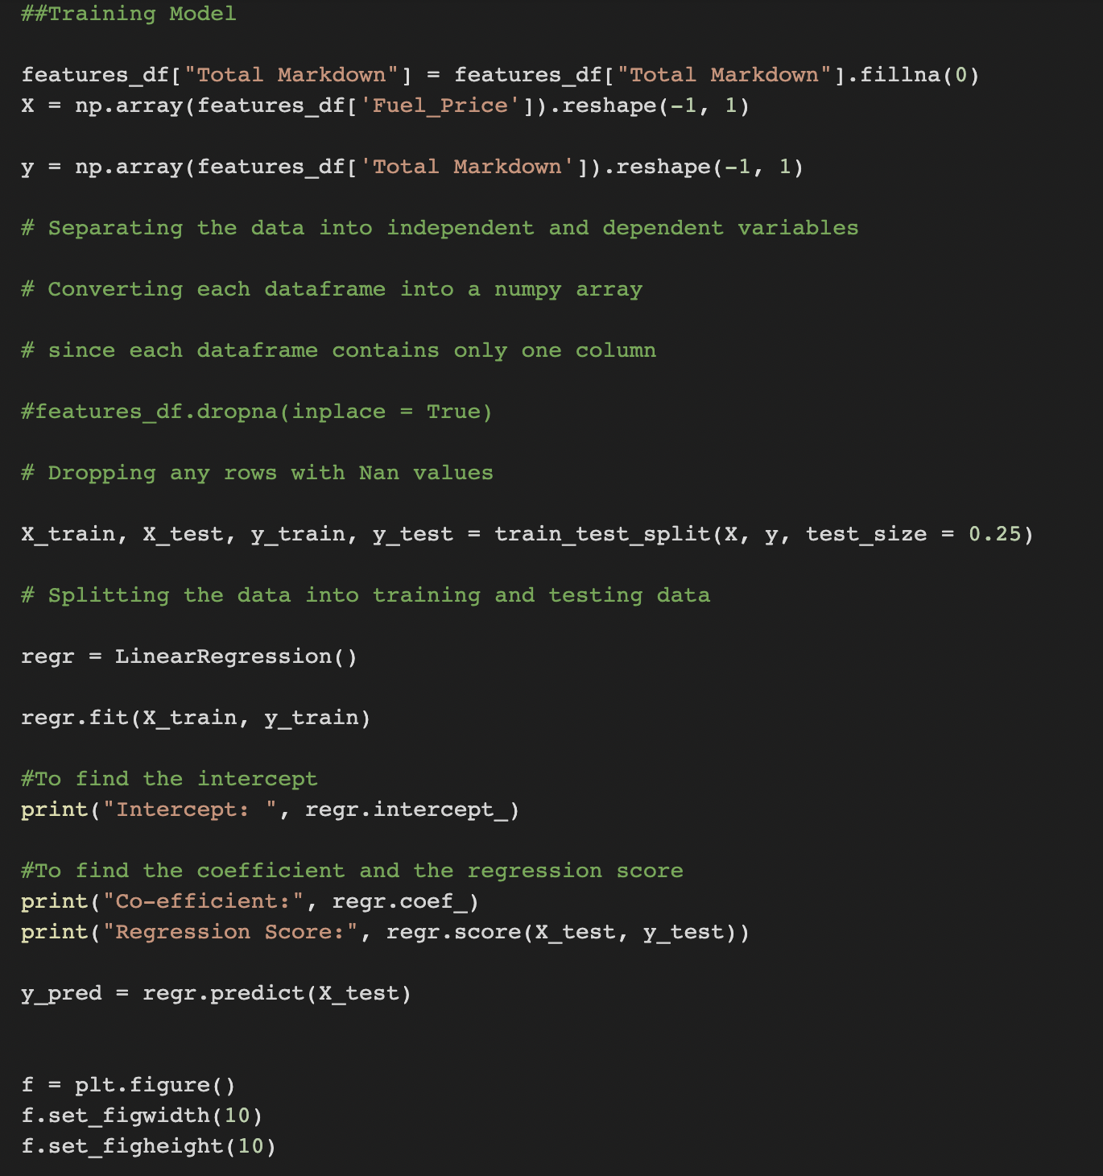
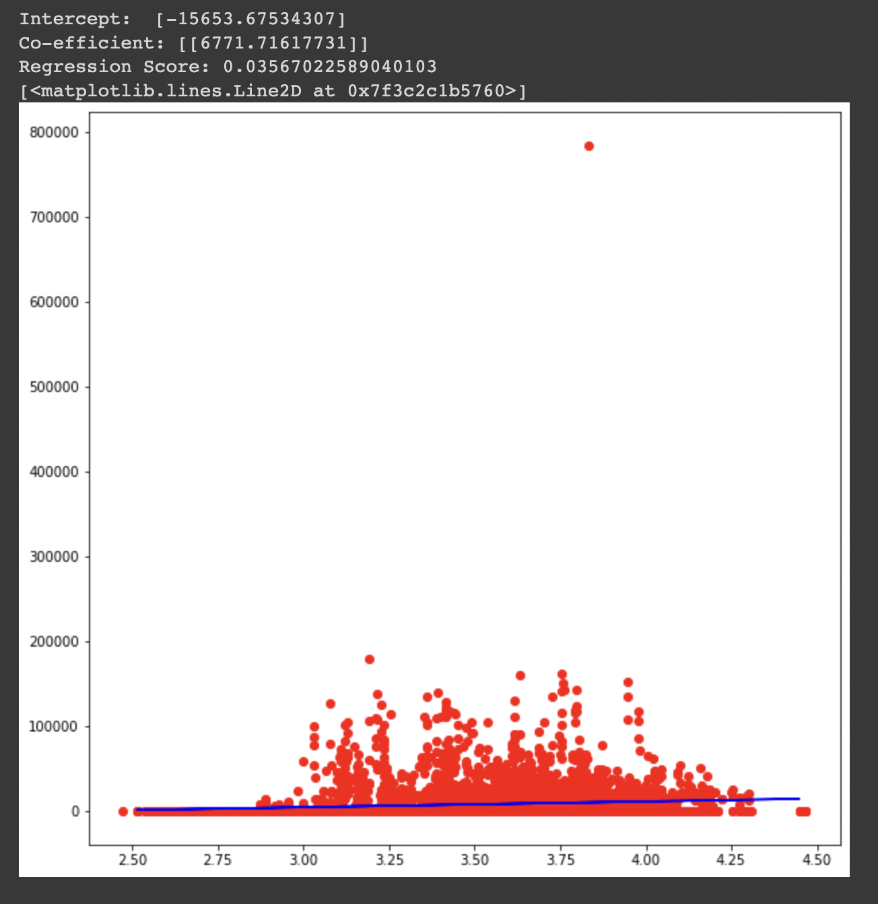

Slide 7
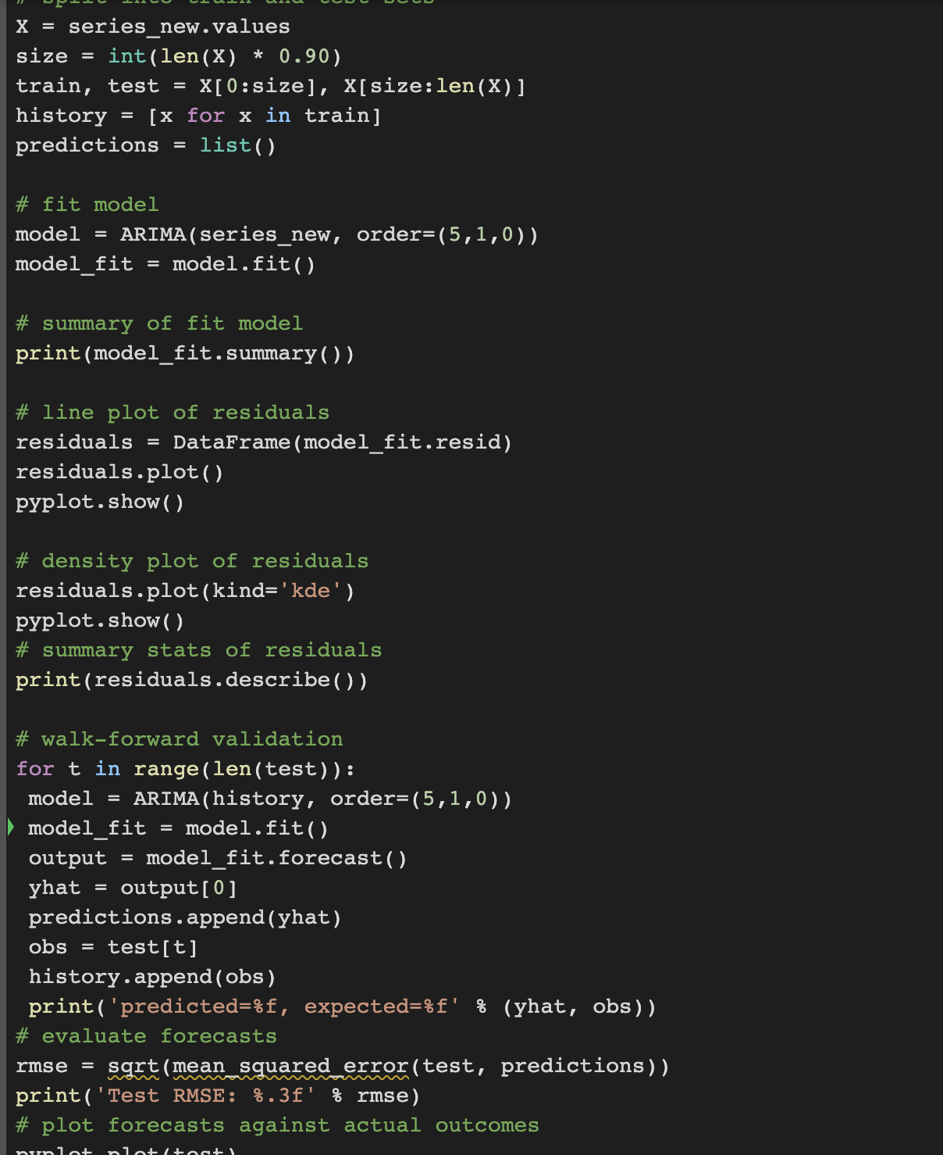

Slide 8
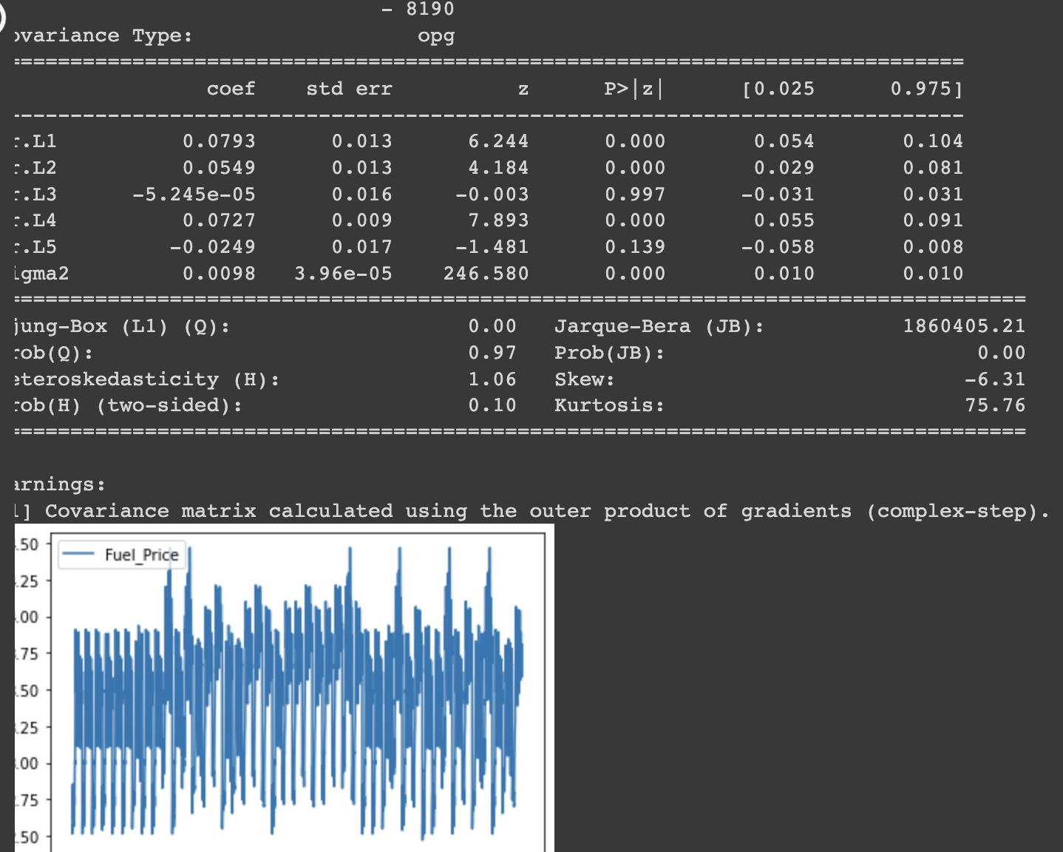

Slide 9
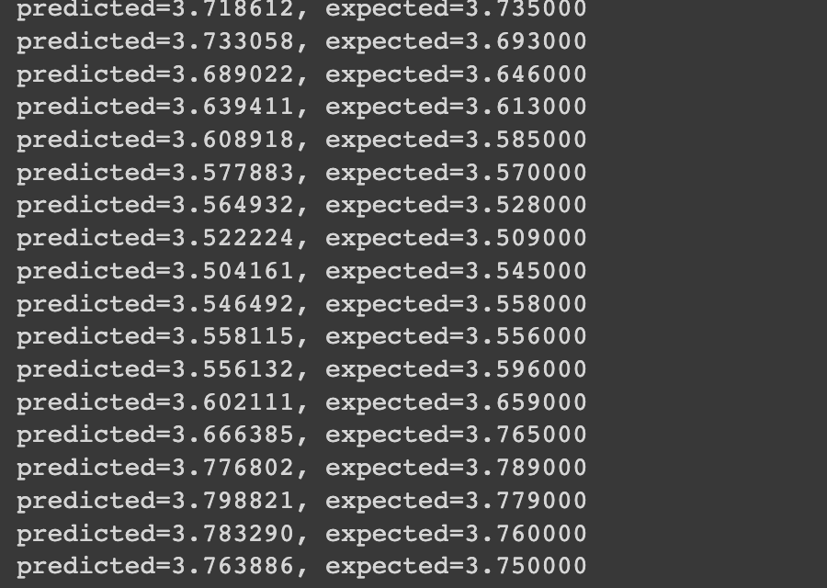

Slide 10
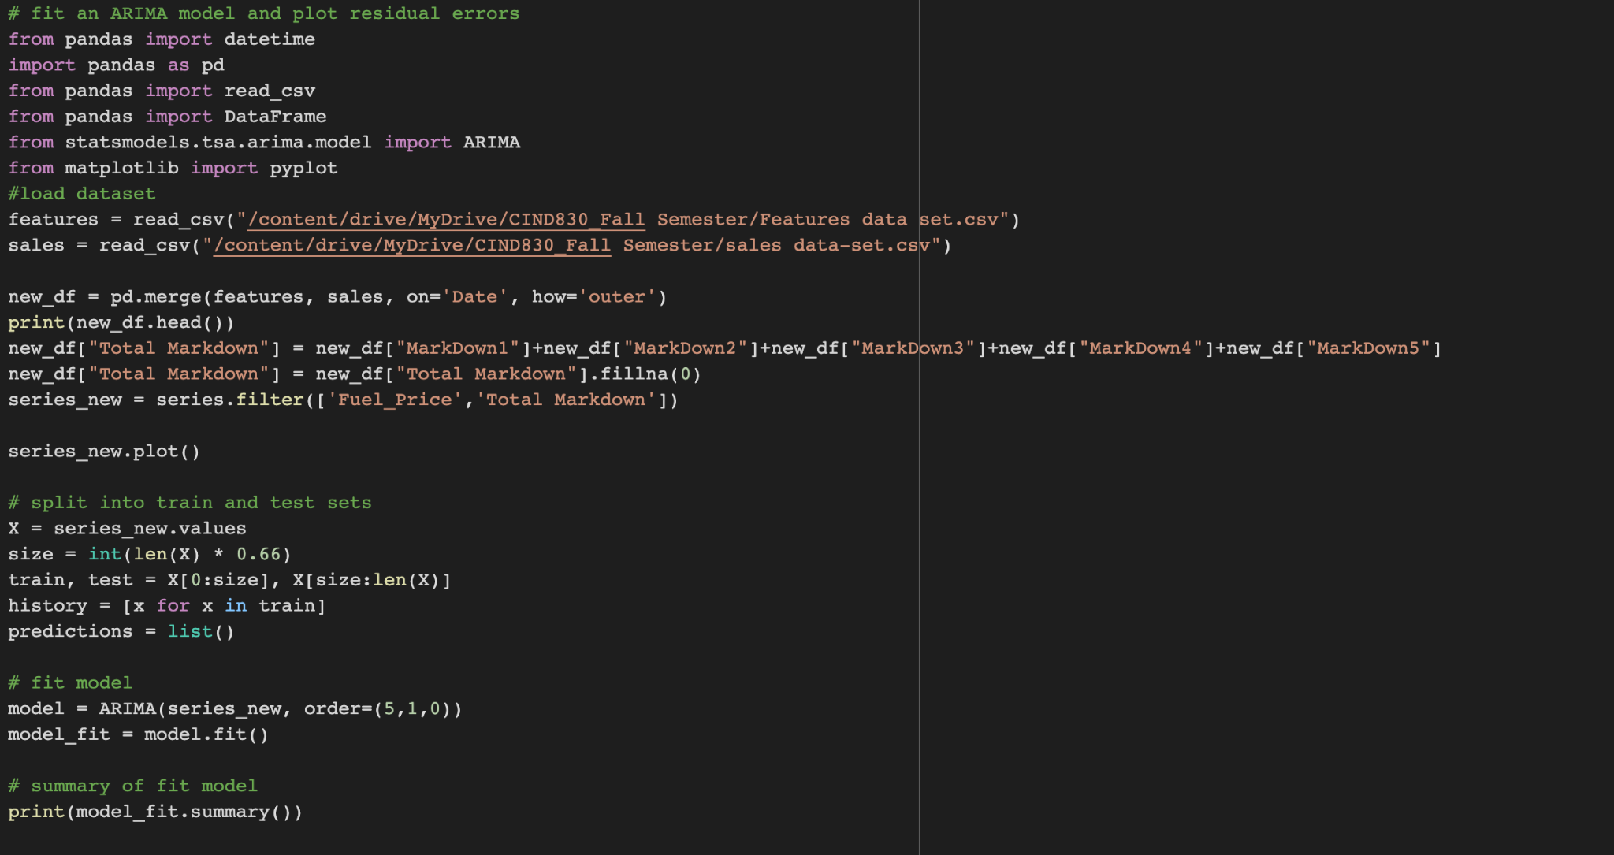

Slide 11
Future Scope of Work:
Look for other variables’ dependency on the Weekly sales
Apply other Time-series based algorithms such as Exponential Smoothing and Seasonal trend Analysis
Calculate AIC for the existing ARIMA Model which is a goodness fit of the model mathematically
Calculate various Accuracy Metrics for this ARIMA Model such as Mean Error, Mean Percentage Error, Mean Min-max Error, etc
Try to build Auto ARIMA Model

Slide 12
Thank you

